Slide 1
MECHANICS OF SOLIDS

Slide 2
LECTURE 0

Slide 3
Mechanics of Solids
PART- I
Mechanics of Rigid Bodies
PART- II
Mechanics of Deformable Bodies
Notes:
Objective
To present the topics thoroughly and directly, allowing fundamental principles to emerge through applications to real world problems
To integrate learning principles and teaching techniques that improves student’s ability to grasp and absorb concepts
Much of engineering mechanics involves the development of mathematical models of the physical world. In particular, visualization of three dimensional physical systems and development of appropriate models.
While physicists are interested primarily in understanding the principles that govern the natural world, and mathematicians focus on developing mathematical models to describe natural phenomena, engineers seek to create what does not exist in nature and to enrich people’s lives by solving problems that confront modern society.
Knowledge of a set of mathematical tools and techniques for solving problems is not sufficient: one must also have motivation, ingenuity and an organized strategy for tackling new problems.

Slide 4
COURSE CONTENT IN BRIEF
PART I Mechanics of Rigid Bodies
Resultant of concurrent and non-concurrent coplanar forces
Equilibrium of concurrent and non-concurrent coplanar forces
Centroid of plane areas
Moment of Inertia of plane areas

Slide 5
PART II Mechanics of Deformable Bodies
6. Simple stresses and strains
7. Statically indeterminate problems and thermal stresses
Stresses due to fluid pressure in thin cylinders
Concepts of SFD and BMD

Slide 6
REFERENCE BOOKS
Engineering Mechanics - Meriam & Craige, John Wiley & Sons.
Engineering Mechanics - Irwing Shames, Prentice Hall of India.
Mechanics for Engineers - Beer and Johnston, McGraw Hills Edition
Mechanics of Materials - E.P.Popov
Mechanics of Materials - E J Hearn
Strength of materials - Beer and Johnston
Strength of materials - F L Singer & Andrew Pytel
Strength of Materials - B.S. Basavarajaiah & P. Mahadevappa
Strength of Materials - S S Bhavikatti

Slide 7
LECTURE 1

Slide 8
Concept of Rigid body
Force and its characteristics
Principle of transmissibility
Classification of Force System
Resultant of Coplanar concurrent forces
Composition of forces
Resolution of a force
Rectangular Components of a force
Sign convention

Slide 9
INTRODUCTION TO RIGID BODY MECHANICS
Rigid Body
A body is said to be rigid if it does not get deformed under the action of external load.
It is defined as a definite amount of matter, the parts of which are fixed in position relative to one another.
Actually solid bodies are never rigid; they deform under the action of applied forces. In those cases where this deformation is negligible compared to the size of the body, the body may be considered to be rigid.

Slide 10
Force
It is defined as the action of one body on another. (OR) It is that agent which causes or tends to cause changes or tends to change the state of rest or motion of a mass.
Characteristics of a force:
1. Magnitude
2. Direction
3. Point of application and
4. Line of action
Example:
P= 100 kN
30˚
A
B
Notes:
Force:
It is defined as the action of one body on another.
OR
It is that agent which causes or tends to cause, changes or tends to change the state of rest or of motion of a mass.
For practical applications, a force must be completely described.
Characteristics of a force:
The force P applied externally has the following characteristics:
Magnitude of the force is 100 kN. Line of action is represented by AB which is inclined at an angle of 30° with the horizontal. An arrow drawn as shown in figure indicates the direction. The point on the body where the arrow makes contact is the point of application (i.e., point A)

Slide 11

Principle of Transmissibility
A
B
P
The state of rest or motion of the block will be the same if a force of magnitude P is applied as a push at A or as a pull at B.
OR
The state of rest or of uniform motion of a rigid body is unaltered if a force acting on the body is replaced by another force of the same magnitude and direction but acting anywhere on the body along the line of action of the replaced force.
Notes:
Principle of transmissibility:
The state of rest or of uniform motion of a rigid body is unaltered if a force acting on the body is replaced by another force of the same magnitude and direction but acting anywhere on the body along the line of action of the replaced force.
OR
The external effect of a force on a rigid body is the same for all points of application along its line of action.
OR
The state of rest or motion of the rigid body is unaltered if a force acting on the body is replaced by another force of the same magnitude and direction but acting anywhere on the body along the line of action of the replaced force.
Example:
In the figure , P is the force acting on a rigid body at point A. As per the law of transmissibility of forces, if the point of application of this force is shifted to B, which is another point on the line of action of the force P, the original state of rest or motion of the body remains unchanged.

Slide 12
Classification of Force System
System of forces
Collinear forces
Coplanar forces
Non coplanar forces
Concurrent forces
Non concurrent forces
Non concurrent forces
Concurrent forces
Like parallel forces
Unlike parallel forces
Like parallel forces
Unlike parallel forces
Notes:
Collinear forces: Line of action of all forces act along the same line.
Example: Forces on a rope in a tug of war.
Coplanar forces: All forces lie on the same plane.
Concurrent forces: Line of action of all forces pass through a single point and the forces lie on the same plane.
Example: Forces on a rod resting against a wall.
Non concurrent forces: All the forces do not meet at a point, but lie in a single plane.
Example: Forces on a ladder resting against a wall and a boy ascending it.
Non coplanar forces: The forces lie on different planes.
Concurrent forces: All forces do not lie on the same plane but their lines of action pass through the same point.
Example: A tripod carrying a camera.
Non concurrent forces: All forces do not lie on the same plane and also their lines of action do not pass through the same point.

Slide 13
RESULTANT OF COPLANAR CONCURRENT FORCE SYSTEM
F₃
F₂
R
F₁
=
θ
A
A
F₄
It is defined as that single force which can replace a set of forces, in a force system, and cause the same external effect.
Notes:
Resultant:
A force that can replace a set of forces, in a force system, and cause the same ‘external effect’ is called the Resultant.
OR
It is defined as that single force which can replace a set of forces, in a force system, and cause the same external effect.
The process of obtaining the resultant of a given force system is called ‘Composition of forces’.

Slide 14
Composition of forces: It is the process of obtaining the resultant of a given force system.
Component of a force : In simple terms, it is the effect of a force in a certain direction.
Resolution of a force: The process of obtaining the components of a force.
Notes:
Component of a force, in simple terms, is the effect of a force in a certain direction. A force can be split into infinite number of components along infinite directions.
Usually, a force is split into two mutually perpendicular components, one along the x-direction and the other along y-direction (generally horizontal and vertical, respectively).
The process of obtaining the components of a force is called ‘Resolution of a force’.

Slide 15
Rectangular Components of a force
F
F
F
F_{y}
=
F_{y}
θ_{x}
θ_{x}
θ_{x}
F_{x}
F_{x}
The components that are mutually perpendicular are called ‘Rectangular Components’.
Consider a force F making an angle θ_{x} with x-axis.
Resolved part of the force F along x-axis is given by F_{x} = F cos θ_{x}
Resolved part of the force F along y-axis is given by F_{y} = F sin θ_{x}
Notes:
Rectangular components
The components that are mutually perpendicular are called ‘Rectangular Components’.
Consider a force F making an angle θ_{x} with x-axis.
Then the resolved part of the force F along x-axis is given by
F_{x} = F cos θ_{x}
The resolved part of the force F along y-axis is given by
F_{y} = F sin θ_{x}

Slide 16
Sign convention
y
y
+ve
x
x
+ve
Notes:
Sign convention
The diagram gives the sign convention for force components, i.e., force components that are directed along positive x-direction are taken +ve for summation along the x-direction. Also force components that are directed along +ve y-direction are taken +ve for summation along the y-direction.

Slide 17
LECTURE 2

Slide 18
Resultant of Coplanar non-concurrent force systems
Moment of a force
Varignon’s theorem
Couple
Moment of a couple
Resolution of a force into a force and couple
Properties of a couple

Slide 19

RESULTANT OF COPLANAR NON-CONCURRENT FORCE SYSTEM
F2
F1
F2
F1
F5
F3
F3
F4
Fig. 1
Fig. 2
Parallel Force System – Lines of action of individual forces are parallel to each other.
Non-Parallel Force System – Lines of action of the forces are not parallel to each other.
Notes:
Coplanar Non-concurrent Force System:
If all the forces in a system lie in the same plane and the lines of action of these forces do not pass through a single point, the system is said to be coplanar non concurrent force system
Parallel Force System – Lines of action of individual forces are parallel to each other.
Non-Parallel Force System – Lines of action of the forces are not parallel to each other.

Slide 20
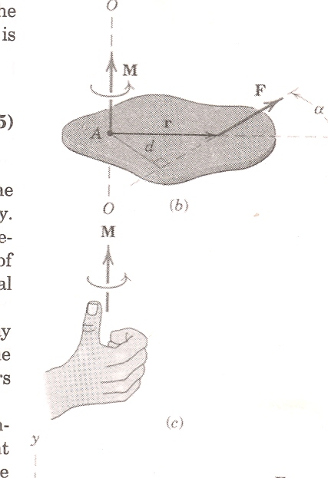
Moment
Moment : measure of rotational effect
Moment of a force about an axis:
Moment Axis: the axis about which rotational tendency is determined.
Moment Center: This is the position of axis on co-planar system.
Moment Arm: Perpendicular distance from the line of action of the force to moment center.
Magnitude of moment:
M_{A} = F×d
= Rotation effect because of the force F, about the point A (about an axis 0-0)
Unit – kN-m, N-mm etc.
Notes:
Moment of a force about an axis:
The applied force besides causing motion, can also tend to rotate the body about an axis. This rotational tendency is known as moment. Moment of a force about a point is the measure of its rotational effect.
Moment is the tendency of a force to make a rigid body to rotate about an axis.
This is a vector quantity having both magnitude and direction
Moment Axis: This is the axis about which rotational tendency is determined. It is perpendicular to the plane comprising moment arm and line of action of the force (axis 0-0 in the figure)
Moment Center: This is the position of axis on co-planar system. (A).
Moment Arm: Perpendicular distance from the line of action of the force to moment center. Distance AB = d.
Magnitude of moment:It is computed as the product of the of the force and the perpendicular distance from the line of action to the point about which moment is computed. (Moment center).
Note:
If a point lies on the line of action of a force, the moment of the force about that point is zero.
The moment of a force has also got direction.
Moments of forces may be added graphically as scalar quantities if a sign convention is adopted.
A force acting on a rigid body is completely defined (except for its exact position on its line of action) if its components F_{x}, F_{y} and its moment M_{A} about A are known (in magnitude and direction)

Slide 21
Sense of a Moment
‘Right Hand Thumb’ rule:
‘If the fingers of the right hand are curled in the direction of rotational tendency of the body, the extended thumb represents the sense of moment vector’.
For the purpose of additions, the moment direction may be considered by using a suitable sign convention such as +ve for counterclockwise and –ve for clockwise rotations or vice-versa.
M
M
Notes:
Sense of a moment:
The sense is obtained by ‘Right Hand Thumb’ rule.
‘If the fingers of the right hand are curled in the direction of rotational tendency of the body, the extended thumb represents the sense of moment vector’.
For the purpose of additions, the moment direction may be considered by using a suitable sign convention such as +ve for counterclockwise and –ve for clockwise rotations or vice-versa.

Slide 22
Varignon’s Theorem (Principle of moments)
Proof (by Scalar Formulation):
Y
R_{y}
Q
R
Q_{y}
D
γ
C
P
q
r
P_{y}
β
B
p
α
X
A
O
Notes:
Varignon’s theorem (principle of moments)
[Varignon – French Mathematician(1654-1722)]
Proof (by Scalar Formulation):
Let ‘R’ be the given force.
‘P’ & ‘Q’ are component forces of ‘R’. ‘O’ is the moment center.
p, r and q are moment arms from ‘O’ of P, R and Q respectively.
α, β and γ are the inclinations of ‘P’, ‘R’ and ‘Q’ respectively w.r.to X – axis.
We have,
R_{y} = P_{y} + Q_{y}
R Sinβ = P Sinα + Q Sin γ ----(1)
From Δle AOB, p/AO = Sin α
From Δle AOC, r/AO = Sin β
From Δle AOD, q/AO = Sin γ
From (1),
R ×(r/AO) = P ×(p/AO) + Q ×(q/AO)
i.e., R × r = P × p + Q × q
Moment of resultant R about O = algebraic sum of moments of component forces P & Q about same moment center ‘O’.

Slide 23
Let ‘R’ be the given force. ‘P’ & ‘Q’ are component forces of ‘R’.‘O’ is the moment center. p, r and q are moment arms from ‘O’ of P, R and Q respectively.α, β and γ are the inclinations of ‘P’, ‘R’ and ‘Q’ respectively w.r.to X – axis.
We have,
R_{y} = P_{y} + Q_{y}
R Sinβ = P Sinα + Q Sin γ ----(1)
From Δle AOB, p/AO = Sin α
From Δle AOC, r/AO = Sin β
From Δle AOD, q/AO = Sin γ

Slide 24
From (1),
R ×(r/AO) = P ×(p/AO) + Q ×(q/AO)
i.e., R × r = P × p + Q × q
Moment of resultant R about O = algebraic sum of moments of component forces P & Q about same moment center ‘O’.

Slide 25
Couple
Two parallel, non collinear (separated by certain distance) forces that are equal in magnitude and opposite in direction form ‘couple’.
F
d
M = F x d
=
F
Couple does not produce any translation but produces only rotation.
Notes:
Couple:
Two parallel, noncollinear forces equal in magnitude and opposite in direction and separated by a definite distance are said to form a couple.
OR
Two parallel, non collinear (separated by certain distance) forces that are equal in magnitude and opposite in direction form ‘couple’.
The algebraic summation of the two forces forming couple is zero.
Hence, couple does not produce any translation and produces only rotation.
Note:
The algebraic sum of the components of the two forces is zero. i.e. the resultant force of a couple is zero
The moment of a couple is constant for any point chosen in the plane of the couple
A couple can be balanced by an equal and opposite couple in the same plane.
Two or more couples can be reduced to a single couple of moment equal to the algebraic sum of the moments of the given couples
The moment of a couple is independent of the choice of the axis of moments (moment centre). The moment of a couple is the same with respect to any axis perpendicular to the plane of the couple.
The effect of a couple is unchanged if the couple is rotated through any angle.
Since the only effect of a couple is a moment and this moment is the same about any point, the effect of a couple is unchanged if :
The couple is rotated though any angle
The couple is shifted to any other position
The couple is replaced by another pair of forces whose rotational effect is the same

Slide 26
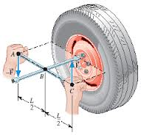
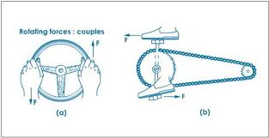

Slide 27
Moment of a Couple
F
d
F
a
Consider two equal and opposite forces separated by a distance ‘d’. Let ‘O’ be the moment center at a distance ‘a’ from one of the forces.
The sum of moments of two forces about the point ‘O’ is,
∑ Mo = F × ( a + d) – F × a = F× d
Thus, the moment of the couple about ‘O’ is independent of the location as it is independent of ‘a’.
Notes:
Consider two equal and opposite forces separated by a distance ‘d’. Let ‘O’ be the moment center at a distance ‘a’ from one of the forces. The sum of moments of two forces about the point ‘O’ is, ∑ Mo = F × ( a + d) – F × a = F× d
Thus, the moment of the couple about ‘O’ is independent of the location as it is independent of ‘a’.
The moment of a couple about any point is constant and is equal to the product of one of the forces and the perpendicular distance between them.

Slide 28
Resolution of a force into a force-couple system
To replace the force F acting at the point A to the point B
F
F
F
B
A
B
A
d
F
F
F
F
B
A
=
B
A
M = F x d
F
Notes:
To replace the force F acting at the point A to the point B is as follows:
Apply two equal and opposite forces of same magnitude & direction as Force F at point B, so that external effect is unchanged.
Of these three forces, two forces i.e., one at A and the other oppositely directed at B form a couple. Moment of this couple, M = F × d.
Third force at B is acting in the same direction as that at A.
Thus, the force F acting at a point such as A in a rigid body can be moved to any other given point B, by adding a couple M. The moment of the couple is equal to moment of the force in its original position about B.

Slide 29
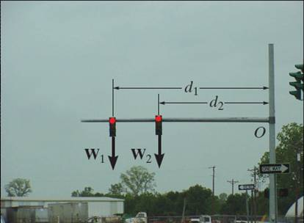
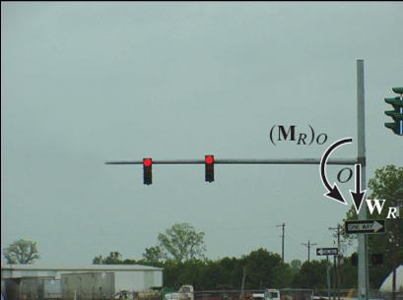

Slide 30
Properties of a Couple
The algebraic sum of the components of the two forces is zero. i.e. the resultant force of a couple is zero
The moment of a couple is constant for any point chosen in the plane of the couple
A couple can be balanced by an equal and opposite couple in the same plane
Two or more couples can be reduced to a single couple of moment equal to the algebraic sum of the moments of the given couples
The moment of a couple is independent of the choice of the axis of moments (moment centre). The moment of a couple is the same with respect to any axis perpendicular to the plane of the couple.
Notes:
Couple:
Two parallel, noncollinear forces equal in magnitude and opposite in direction and separated by a definite distance are said to form a couple.
OR
Two parallel, non collinear (separated by certain distance) forces that are equal in magnitude and opposite in direction form ‘couple’.
The algebraic summation of the two forces forming couple is zero.
Hence, couple does not produce any translation and produces only rotation.
Note:
The algebraic sum of the components of the two forces is zero. i.e. the resultant force of a couple is zero
The moment of a couple is constant for any point chosen in the plane of the couple
A couple can be balanced by an equal and opposite couple in the same plane.
Two or more couples can be reduced to a single couple of moment equal to the algebraic sum of the moments of the given couples
The moment of a couple is independent of the choice of the axis of moments (moment centre). The moment of a couple is the same with respect to any axis perpendicular to the plane of the couple.
The effect of a couple is unchanged if the couple is rotated through any angle.
Since the only effect of a couple is a moment and this moment is the same about any point, the effect of a couple is unchanged if :
The couple is rotated though any angle
The couple is shifted to any other position
The couple is replaced by another pair of forces whose rotational effect is the same

Slide 31
Properties of a Couple cont…
The effect of a couple is unchanged if the couple is rotated through any angle.
Since the only effect of a couple is a moment and this moment is the same about any point, the effect of a couple is unchanged if :
The couple is rotated though any angle.
The couple is shifted to any other position.
The couple is replaced by another pair of forces whose rotational effect is the same
Notes:
Couple:
Two parallel, noncollinear forces equal in magnitude and opposite in direction and separated by a definite distance are said to form a couple.
OR
Two parallel, non collinear (separated by certain distance) forces that are equal in magnitude and opposite in direction form ‘couple’.
The algebraic summation of the two forces forming couple is zero.
Hence, couple does not produce any translation and produces only rotation.
Note:
The algebraic sum of the components of the two forces is zero. i.e. the resultant force of a couple is zero
The moment of a couple is constant for any point chosen in the plane of the couple
A couple can be balanced by an equal and opposite couple in the same plane.
Two or more couples can be reduced to a single couple of moment equal to the algebraic sum of the moments of the given couples
The moment of a couple is independent of the choice of the axis of moments (moment centre). The moment of a couple is the same with respect to any axis perpendicular to the plane of the couple.
The effect of a couple is unchanged if the couple is rotated through any angle.
Since the only effect of a couple is a moment and this moment is the same about any point, the effect of a couple is unchanged if :
The couple is rotated though any angle
The couple is shifted to any other position
The couple is replaced by another pair of forces whose rotational effect is the same

Slide 32
LECTURE 3

Slide 33
Application Problems

Slide 34
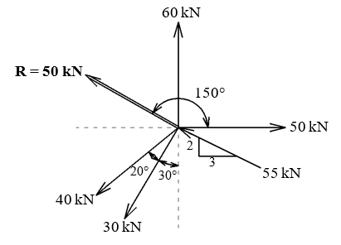
A system of concurrent coplanar forces has six forces of which only five forces are shown in the Figure. If the resultant force R = 50 kN is acting as shown, obtain the unknown sixth force

Slide 35
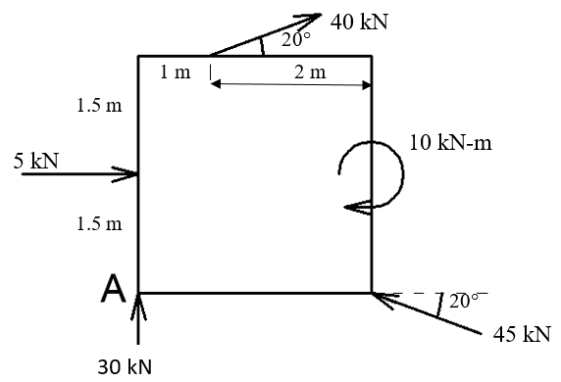
Locate the resultant of the non-concurrent force system shown in the figure with respect to ‘A’

Slide 36
LECTURE 4

Slide 37
Replace the 50 N force applied at B by a force-couple system acting at ‘A’.
A
50 mm
B
30˚
100 mm
50 N

Slide 38
For the configuration shown in the figure, resultant of the force system acting on the frame passes through the point B and E as shown in the figure. Find the values of F and M.
200N
A
200mm
F
B
175N
200mm
M
45˚
F
30˚
C
E
200mm
200mm
200mm
200mm
300N
G
30˚
150N

Slide 39
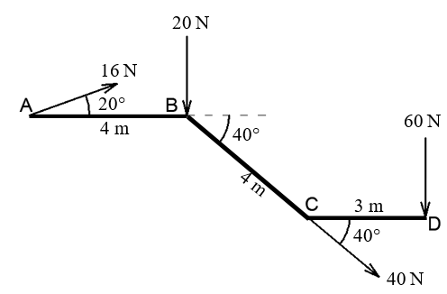
5. Locate the resultant with respect to point C.

Slide 40
TUTORIAL 1
HOME

Slide 41
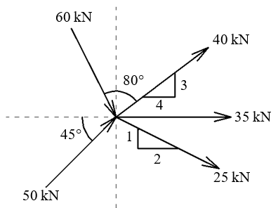
A system of concurrent coplanar forces has six forces of which only five forces are shown in the Figure. If the resultant force R = 100 kN is acting horizontally towards left, obtain the unknown sixth force.

Slide 42
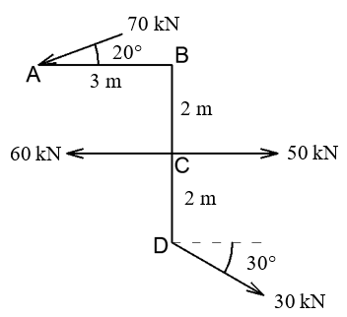
Locate the resultant of the force system shown in figure with respect to ‘A’.
HOME

Slide 43
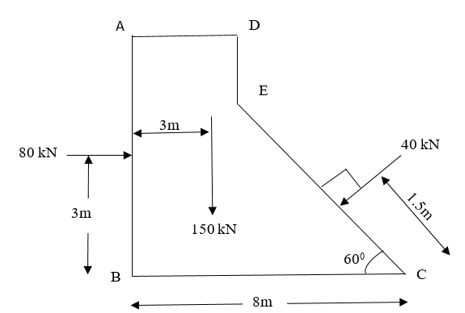
8. Determine the resultant of the force system as shown in figure. Locate its intersection with base BC.

Slide 44
TUTORIAL (Additional)

Slide 45
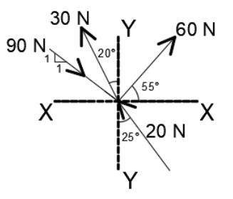
Determine the resultant of force system comprising of four forces shown in the figure.

Slide 46
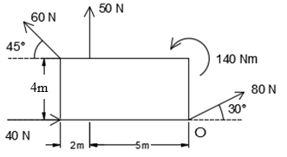
Find magnitude, direction and position of the resultant force for the system of forces shown in figure with respect to ‘O’.

Slide 47
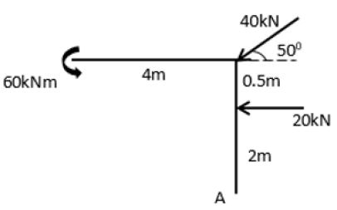
Locate the resultant of the coplanar force system shown in figure with respect to A

Slide 48
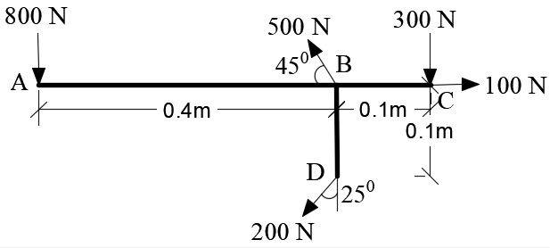
A bracket ABCD is subjected to a system of coplanar forces as shown in the figure. Determine the magnitude of resultant and locate it w.r.t A.

